Slide 1

Digital Portfolio
STUDENT NAME | JAYANEE R
REGISTER NO AND NMID | 43CA14D90C399CA876847117777B6866
DEPARTMENT | BCA / II YEAR
COLLEGE | GOVT TIRUMAGAL MILLS COLLEGE
UNIVERSITY | THIRUVALLUVAR UNIVERSITY

Slide 2
Amma Restaurant
“Taste that feels like home”

Slide 3
Agenda
Problem Statement
Project Overview
End Users
Tools and Technology
Website Design And Layout
Features And Functionality
Results and Screenshots
Conclusion
Github link

Slide 4
Problem Statement
Many small restaurants lack a simple online platform to showcase their menu.
Customers often face difficulty in quickly choosing food and placing orders.
Manual order management can lead to errors and delays.
There is a need for a user-friendly digital interface for ordering food.
This project aims to create a simple, interactive webpage to solve these issues efficiently.

Slide 5
Project Overview
Created a responsive food ordering webpage using HTML, CSS, and JavaScript.
Shows a menu with images, prices, and hover effects for better user experience.
Includes an interactive order form with validation and dynamic success message.
Designed for easy navigation, visual appeal, and simple online ordering.

Slide 6
End Users
Small restaurants looking for a simple online menu display.
Customers who want quick and easy food ordering.
Users who prefer visual selection with images and prices.
People learning basic web development with HTML, CSS, and JS.
Anyone needing a lightweight, interactive ordering interface.

Slide 7
Tools and Technologies
HTML – To structure the webpage and create forms.
CSS – For styling, layout, hover effects, and backgrounds.
JavaScript – To handle form submission and display success messages.
Images – To visually showcase the food menu.
Browser – To run and test the interactive webpage.

Slide 8
website Design and Layout
Header Section displays the restaurant name and catchy slogan.
Menu Section uses flexbox to arrange food items with images and prices.
Hover Effects enhance interactivity by scaling cards and changing background color.
Order Form Section collects customer details and order information.
Overall layout is clean, user-friendly, and visually appealing.

Slide 9
Features and Functionality
Displays food menu with images and prices.
Hover animations enhance interactivity on menu cards.
Order form collects customer details and quantity.
Validation and success message ensure smooth ordering.
Designed to be responsive and user-friendly.

Slide 10
Results and Screenshots
Food menu displayed with images and prices.
Hover effects make menu interactive.
Order form works with validation.
Success message shown on submission.
Screenshots show menu, form, and confirmation.

Slide 11
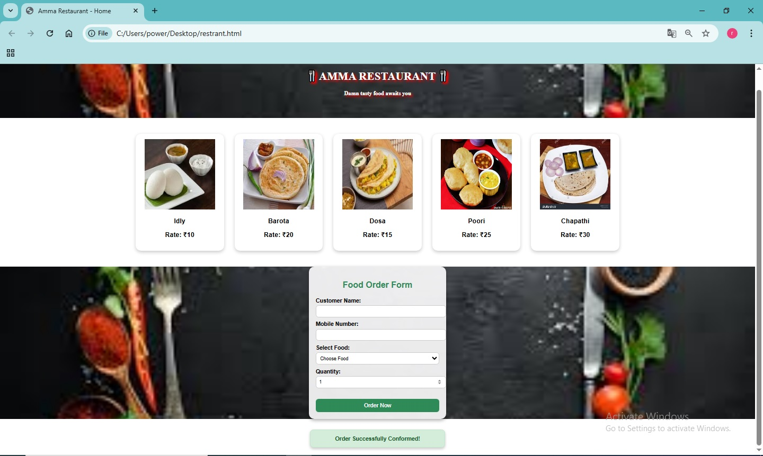
Results and Screenshots

Slide 12
Conclusion
Created a simple, interactive food ordering webpage.
Menu shows images and prices.
Hover effects improve user experience.
Order form with validation works smoothly.
Success message confirms orders instantly.

Slide 13
Github link
https://github.com/jayanee-19/TNSDC-FWD-JAYANEE

